Slide 1

Team Members:
Jairo Arreola (jaa0019@uah.edu)
Daniel Burris (dab0021@uah.edu)
Komlan Maglo (kmm0048@uah.edu)
Adam Walters (atw0015@uah.edu)
CPE 495-01 Computer Engineering Design I
Electrical and Computer Engineering
The University of Alabama-Huntsville

Slide 2

Project Summary
The UAH Navigation Application will give users the luxury of having a refinement of the Google Maps API that will lead them to their desired location within the UAH Campus. The Application will allow users to search for their destination by selecting the Class ID, Room Number, or Building ID, and will lead the user to the room. When the user enters a building, the app will open up a floor plan with a traced path to lead the users to their destination. This Application will focus on development for Android-compatible devices.
Notes:
Our goal is to develop an Android App that allows for quick navigation around the UAH Campus. You will be able to enter your class information and receive a drawn out path showing you how to get to the classroom.

Slide 3
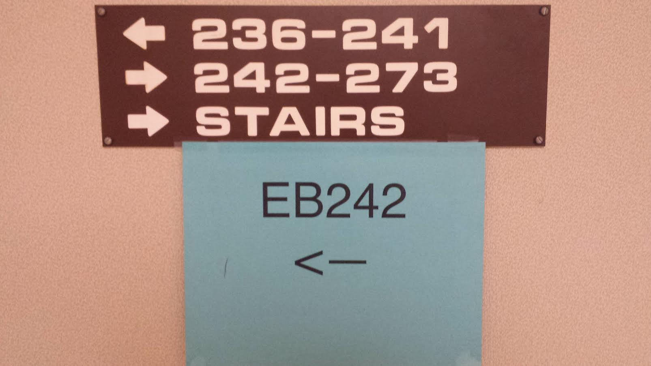

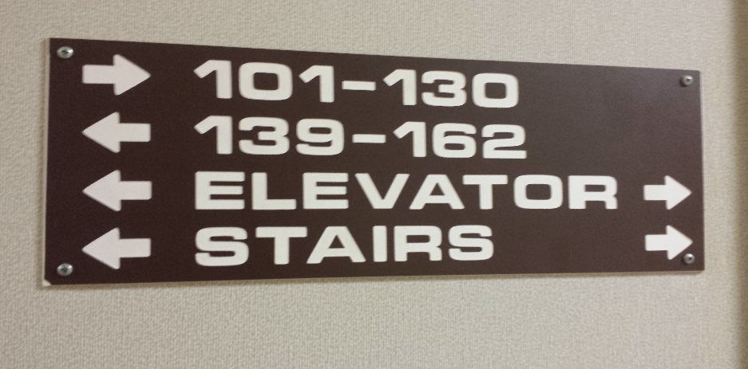

The Need for this Project
Scenario 1
Scenario 2

Slide 4
The Team
Adam Walters - Project Lead. Navigation Lead.
Jairo Arreola – Utility Programmer. Navigation Auxiliary.
Komlan Maglo - Graphical Interface Designer.
Daniel Burris - Database Manager. GUI Designer Assistant.

Slide 5
Marketing Requirements
Low Data Usage.
Low Power Consumption.
Exterior Navigation using Google Maps’ API.
Quick Navigation of App’s GUI. (3-Tap Design)
Provides Floor Plans of Buildings.

Slide 6
Engineering Requirements
SQLite3 Database
Easily updatable.
Minimum size of 32KB
Custom API for access and entry.
Android API 16.
API 16 supports up to 98% of current android phones. (02/2017, Android’s Global Distribution Chart)
Interior Navigation
Graph-Based Approach
Abundance of search algorithms.
Static for each floorplan.
Base case: Engineering Building.

Slide 7
Market & Competition
No direct competition.
Other Navigational Apps do not direct users to specific rooms.
None are specific to the UAH Campus.

Slide 8

Existing Projects
UAH Events App
Play Store description
“Welcome to Charger Nation! This is the official app for the University of Alabama in Huntsville’s Student Affairs & Campus Events. Here you will find interactive UAH event schedules and program details.”

Slide 9
Proposed Approach
Interface with Google Maps to handle exterior navigation.
When a building is entered, an optimal route will be drawn on an image of the floorplan.
Store class information in Database for ease of access.

Slide 10
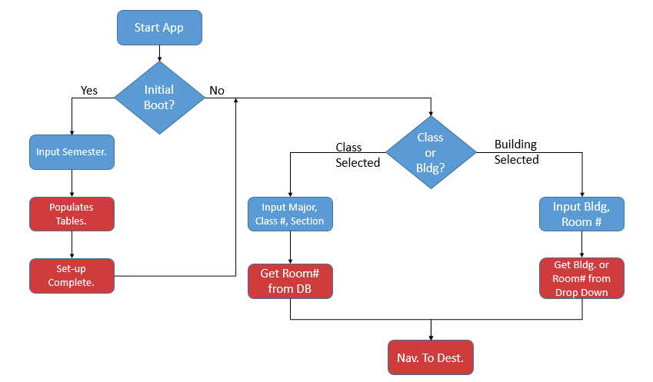
System Design Description
* Blue represents User prompts. Red represents Application Prompts.

Slide 11
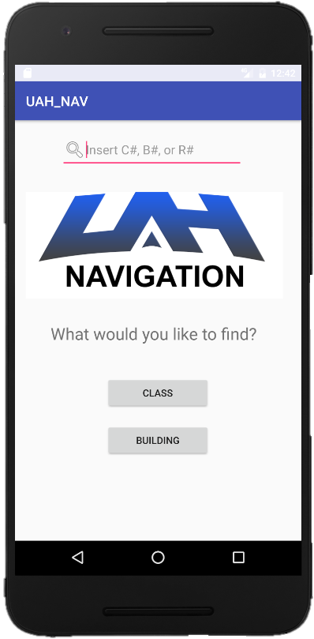
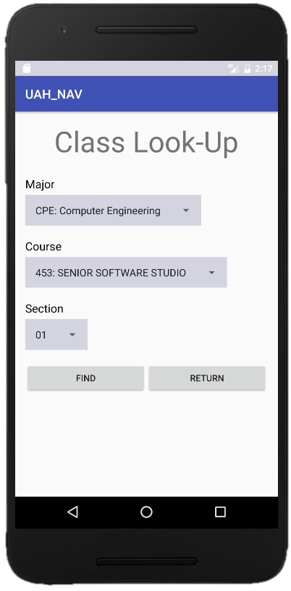
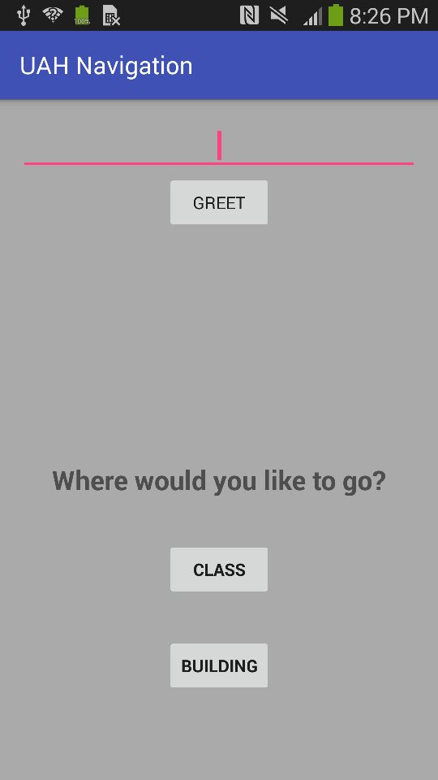
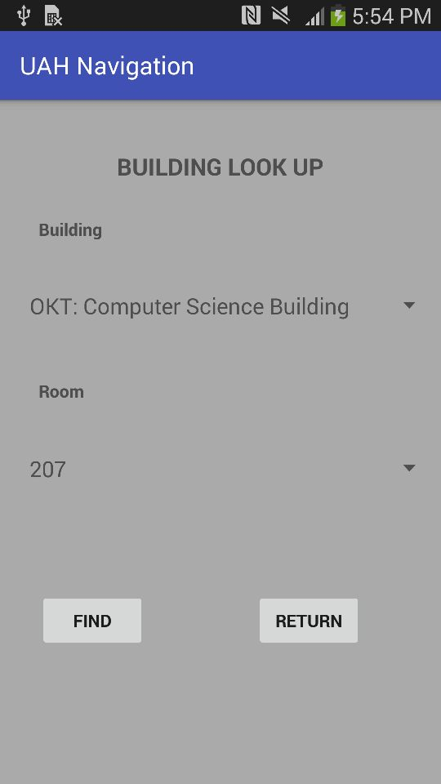

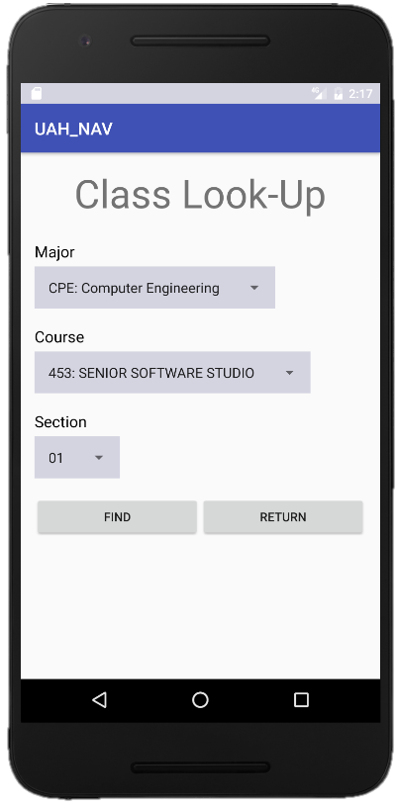
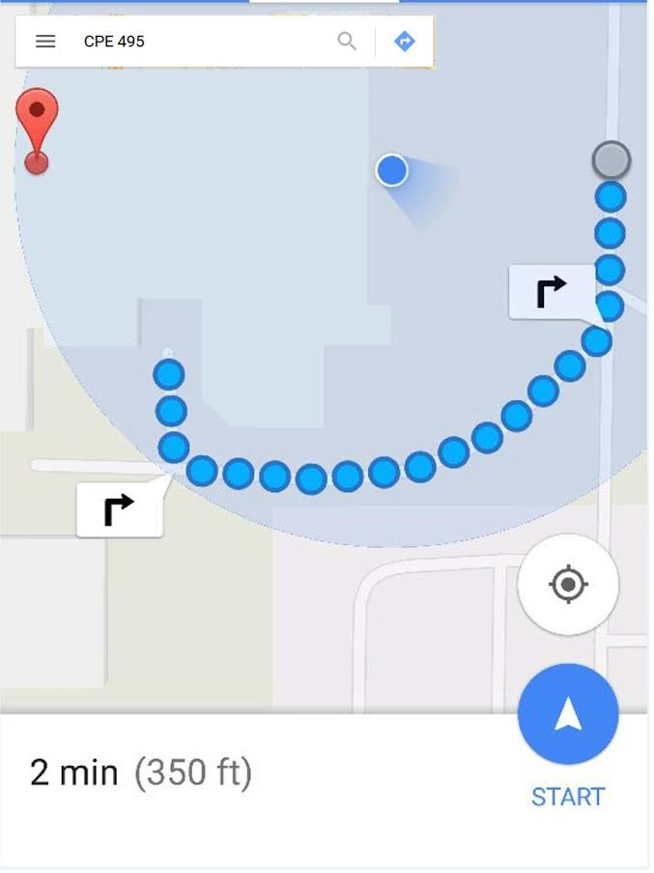
The UAH Navigation App
Building Selected
Time
Find
02:20 pm ▼

Slide 12
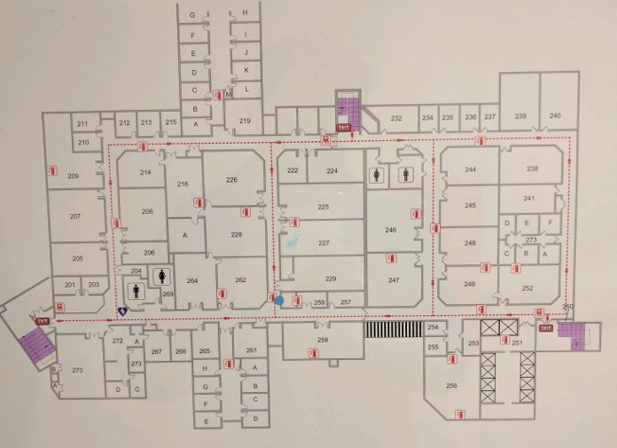
Back
New Search
New Search
Done

Slide 13
Current Progress
Web-Scraping Algorithm has been implemented.
Database management classes have been created.
Database API has been implemented.
Base design for GUI has been finished.
Designed Exception Handling for Navigation.
Text-based to Image-based.
Image-based navigation will now be the method used for interior navigation.
Image-based is more visually appealing than its text-based counterpart.

Slide 14
Response to Feedback
Changed text-based navigation to image-based.
Image-based navigation is far more helpful than our text-based approach.
Updated Engineering Requirements.
The old requirements dealt with generalities not specifics.
Expanded System Description Design.
Added more detail to the System Design Description Graph to more accurately reflect the app’s behavioral design.
Handicap Accessibility Design.
This design would prioritize elevators over stairs.
Data Mine for Optimized Routes.
This would track the user’s route to find better routes.
Notes:
(Regarding Handicap) However, this would require a redesign of the current interior navigation.
(Regarding Data Mine) However, this would require a different Database methodology. Also, we would run into privacy concerns with the tracking of users.

Slide 15
Testing Plan
Test-Driven Development Approach.
Unit Tests (JUnit)
Classes.
Static Methods.
Acceptance Tests (Espresso)
Button Functionality Testing.
Resolution Testing.
GPS Location Testing.
Using Power Mockito and Mockito Library

Slide 16
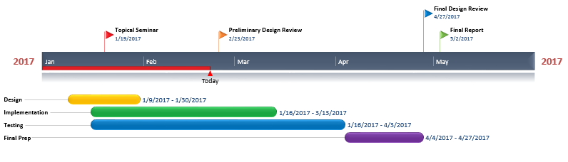
CPE 496 Timeline

Slide 17
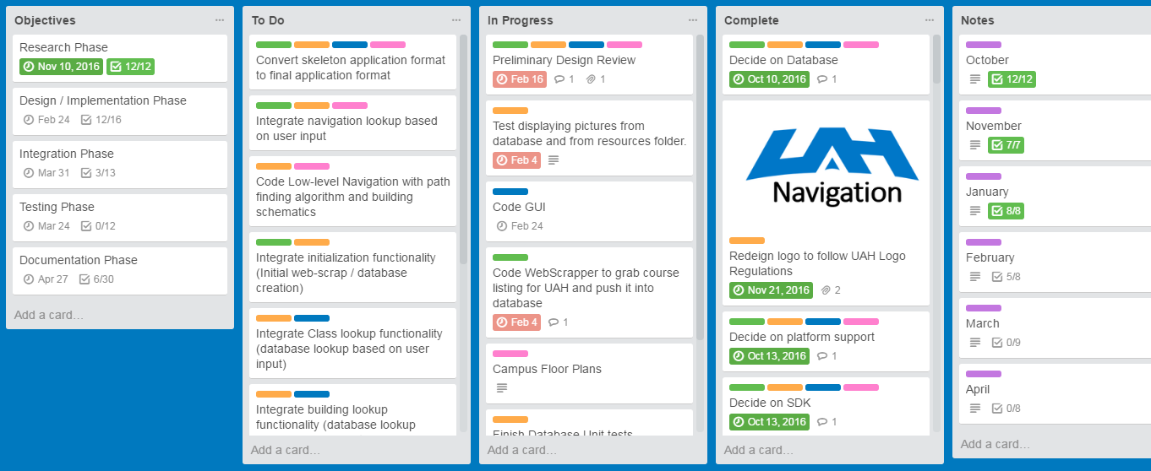
Project Task Manager
https://trello.com/b/iZJ03jLi/app

Slide 18
Cost Estimation
Low Immediate Cost.
Free IDE and Development Kit.
Google Play Store fee ($25)
Individual Labor Hours = 5 Hours per Week * 16 Weeks * 4 Members = 320 Hours
Meeting Hours = 2 Hours per Day * 2 Days per Week * 16 Weeks = 64 Hours

Slide 19
Final Project Deliverables
Fully functional indoor UAH Navigational App for Android Devices.
Ready to download to most Android Devices.

Slide 20
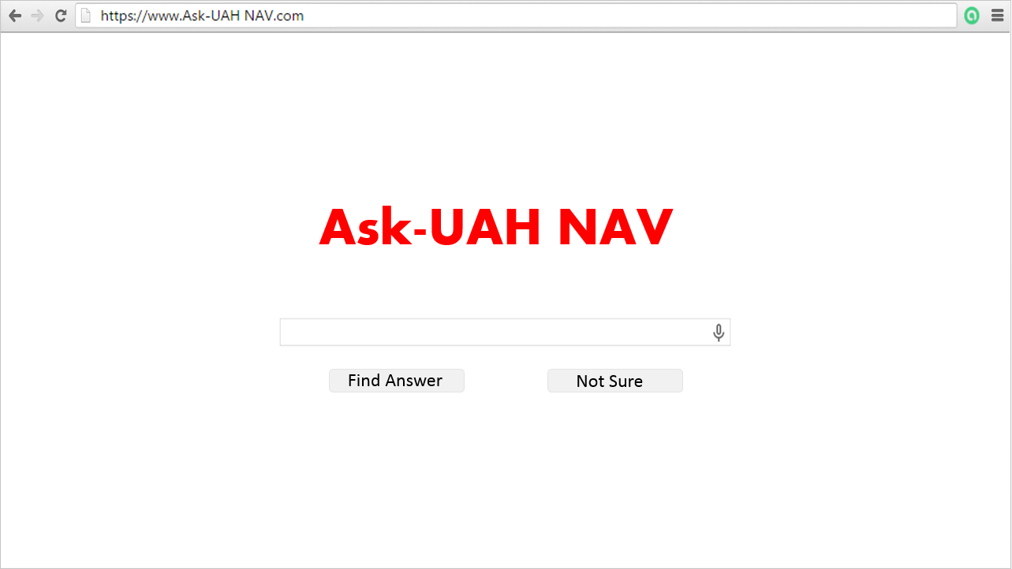
Questions?

